Slide 1

Hidde de Smet
As a certified Azure Solution Architect, I specialize in designing, implementing, and managing cloud-based solutions using Scrum and DevOps methodologies. My expertise lies in supporting applications throughout their lifecycle and advocating for agile processes, DevOps, testing, and continuous delivery. I am passionate about utilizing cloud technology and best practices to optimize performance, reduce costs, and align with business objectives. My commitment to continuous learning and industry developments positions me as an ideal candidate to drive digital transformation and the adoption of agile practices in any organization.
Azure Architect/ Consultant
Hello, my name is Hidde, and I’m a proud father living in the picturesque village of Jisp in The Netherlands. In my leisure time, I enjoy engaging in various sports activities, including everything from racket sports to cycling, which keeps me active and energized. I’m also a nature and birdwatching enthusiast, finding joy in exploring nature trails and observing wildlife in its natural habitat.
Azure (Solution) Architect Design & build modern applications using cloud technology & governance within organizations
Cloud Consultant Provide guidance and technical expertise in implementing cloud strategies and platforms
DevOps Consultant Integrated and implemented DevOps practices to create a robust engineering culture within organizations.
Cloud Architecture design
Azure Cloud Infrastructure
Azure Cloud governance
Infrastructure as Code
Azure Network design
DevOps
CI/CD
C#
AI
Data
2001-2005 Bachelor of Science Business Informatics Amsterdam University of Applied Sciences
PSM 1
Azure Administrator Associate AZ-104
Azure Developer Associate AZ-204
Azure Solution Architect Expert AZ-305
DevOps Engineer Expert AZ-400
Azure Network Engineer Associate AZ-700
Cybersecurity Architect Expert SC-100
Security Operations Analyst Associate SC-200
Azure AI Engineer Associate AI-102

Slide 2









ONVZ | Azure Architect
Period (Dec 2022-March 2024)
As part of the Cloud Competence Center team, my responsibilities include drafting governance frameworks and establishing policies for the effective use of Azure, ensuring a secure and efficient networking environment, and advising C-level executives on the strategic adoption of Azure to drive corporate innovation.
I manage cloud resources with a keen focus on Infrastructure as Code (IaC) and constantly seek to innovate by conducting research and developing proof of concepts (POCs) to stay ahead of technological advancements. This research is essential to our continuous improvement and positions us at the forefront of cloud technologies.
In a separate capacity, I work on refining our Azure DevOps environment goes beyond enhancing CI/CD pipelines for better agility in our software development lifecycle. This role also involves a meticulous review of user rights and managing licenses to ensure compliance and optimal resource allocation. I focus on maintaining a balance between accessibility and security, safeguarding our systems while facilitating a productive and seamless development process.
Technologies used: Azure, Azure DevOps, Lucid (Scale/Chart)
ODNZKG | Azure DevOps Consultant / Scrum trainer
Period (Oct 2023-March 2024)
As a DevOps consultant, I conduct comprehensive workshops on Scrum and Azure DevOps, equipping teams with the knowledge to improve agility and efficiency. My expertise extends to crafting high-level designs(HLD) and detailed low-level designs(LLD) that underpin robust and scalable systems.
A key part of my role involves reinforcing security measures within the development process, along with devising effective branching strategies and policies to maintain code integrity and streamline version control. These contributions are pivotal in fortifying the development lifecycle against vulnerabilities and ensuring seamless integration and delivery workflows.
Technologies used: Azure DevOps, Scrum

Slide 3

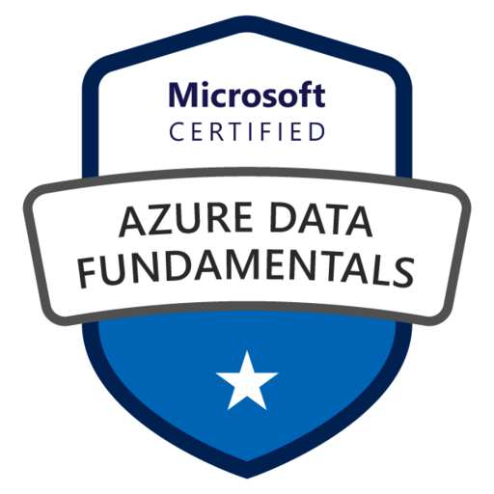





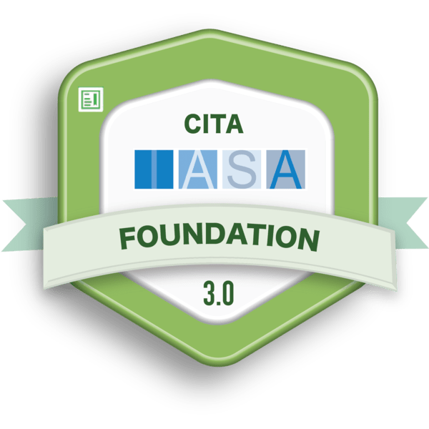
Topigs Norsvin | Azure Architect
Period (March 2023-May 2023)
In my role, I took charge of designing an Azure B2C identity management solution, focusing on customization to align with our organization's unique user experience and branding needs. To achieve this, I utilized HTML and CSS, enabling precise control over the user interface's appearance. The customization files, including the HTML and CSS, were strategically stored in an Azure storage account. This approach was extended to the creation of user flow processes for sign-in, password resets, and other authentication scenarios, ensuring a seamless and secure user experience.
Additionally, I prioritized the inclusion of multiple language options to cater to international users, enhancing accessibility and user satisfaction across diverse demographic groups. Furthermore, the solution was designed to integrate smoothly with Microsoft Entra Identity and Governance capabilities, as well as with SAML (Security Assertion Markup Language) protocols for secure and efficient cross-domain authentication. This integration facilitates a robust, scalable, and secure identity management system that supports a wide range of authentication mechanisms, including Multi-Factor Authentication (MFA) to bolster security and trust, meeting the complex needs of our global user base.
Technologies used: Azure, Azure B2C, Entra ID, HTML/CSS
Vidara | Developer
Period (March 2023-May 2023)
I contributed to the development of Wortell's MDR platform, Vidara, a sophisticated tool designed to interface with Sentinel for the automated closing of alerts and the application of various business logic. Vidara serves as a critical layer, enhancing Sentinel's capabilities by automating response actions and streamlining security operations. My primary focus was on developing the infrastructure as code (IaC), laying the foundational architecture that enables scalable, efficient, and reliable deployment of Vidara's services. This role demanded a deep understanding of cloud infrastructure principles and the ability to implement them in a way that supports the platform's complex functionalities.
Beyond my focus on infrastructure, I also played a supportive role in other aspects of Vidara's development, contributing to the overall design and implementation of the tool. This experience underscored the importance of a multifaceted approach to platform development, where infrastructure expertise complements broader development efforts to create a robust and effective security solution.
Technologies used: Pulumi, .Net core 6/7, CQRS, Micro services, Tye, Hangfire, Kubernetes, Azure container apps, Blazor, MongoDB

Slide 4
Nyenrode | Developer
Period (Sept 2022-Dec 2022)
In the development of an Azure Service Bus solution for Nyenrode, a range of cutting-edge technologies was leveraged to optimize the institution's financial processes. The project, as highlighted by Wortell, utilized Azure Logic Apps, Azure Functions, and Azure Service Bus to create a seamless and efficient pipeline. By integrating CosmosDB for data storage and management, and utilizing C# for the core programming, the solution embodied a robust, scalable architecture. This sophisticated use of technology not only streamlined Nyenrode's operations but also aligned with the best-of-suite strategy, ensuring that the institution's financial processes were optimized to the highest standards. The implementation showcased the power of Azure's cloud capabilities in transforming educational administration, setting a new benchmark for efficiency and innovation.
Technologies used: Logic Apps, Azure functions, Azure ServiceBus, CosmosDB, C#
Big Bazar | Coding Architect
Period (Dec 2020-Feb 2023)
For Big Bazar, I was instrumental in developing a comprehensive system designed to meticulously manage inventories, distribution, receipts, orders, and more, thereby enhancing operational efficiency and accuracy. The project tapped into the power of Azure, utilizing Azure Functions for seamless data conversions, which served as the backbone for processing and manipulating vast amounts of data in real time. Logic Apps were employed to orchestrate and automate workflows, ensuring smooth transitions between different operational phases. Storage accounts with containers, alongside message queues, were strategically implemented as triggers to prompt actions within the system, ensuring timely responses to data changes or incoming requests.
Further enhancing the system's capabilities, an SQL database was used for structured data storage, enabling complex queries and data analysis. Azure App Services facilitated the hosting of backend services, ensuring scalability and reliability, while Automation and API Management played critical roles in streamlining operations and securing interfaces for third-party integrations. This multi-faceted approach not only optimized Big Bazar's inventory and distribution processes but also laid the groundwork for advanced features such as sales forecasting, thereby providing a holistic solution to meet the dynamic needs of the retail giant. The project is a testament to the versatility and scalability of Azure technologies in addressing complex business challenges, as detailed in Wortell's case study on stock assurance and sales forecasting for Big Bazar.
Technologies used: Azure, C#

Slide 5
Emolife | Developer/Architect/Scrum Master
Period (Oct 2016-Feb 2020)
In my role, I took on the challenge of technical project leadership, steering the development and management of a wide array of digital solutions. This included both internal and external web applications, client/server applications, databases, and specialized Microsoft Office applications. My responsibilities extended to conducting thorough research and providing insightful advice on emerging products and technologies, ensuring that our projects remained at the forefront of innovation.
A significant part of my role involved establishing and maintaining standards for server configuration and application development, including programming standards that fostered consistency and quality across our projects. Documentation was a critical component of my responsibilities; I authored comprehensive materials ranging from project initiation documents and functional designs to technical designs and improvement proposals, as well as detailed reports.
Furthermore, I was actively involved in the enrichment of our team's skills and knowledge. This was achieved through organizing and conducting internal training sessions, tailored to the specific needs and challenges of our projects. Additionally, I played a key role in coaching colleagues, offering constructive feedback and facilitating knowledge transfer to strengthen our team's capabilities and foster a collaborative and learning-oriented environment.
Technologies used: Azure, C#
KPMG | Developer/Tester/Team Lead
Period (Sept 2005-Oct 2016)
Throughout my tenure at KPMG, I led the development of several critical web applications, serving as a .Net Developer, Tester, and Team Lead. I spearheaded the construction of a four-layer web application encompassing Business Logic, Data Access, WebApp, and Entities, managing project teams to ensure timely delivery, quality, and adherence to specifications. My role involved presenting the final product to users, creating comprehensive documentation, and facilitating communication with end-users. Notably, I developed a web application to provide insights into users' call and printing behaviors, encouraging more efficient practices among KPMG staff. Additionally, I played a key role in the tech refresh of the application landscape, porting web applications to .net framework 4.5, and improving application architecture on SharePoint, including customizing the look and feel and configuring backups with DocAve. My contributions have significantly streamlined processes and enhanced asset management and monitoring within KPMG.
Technologies used: Sharepoint, C#, SQL, MVC, WebForms

